Slide 1
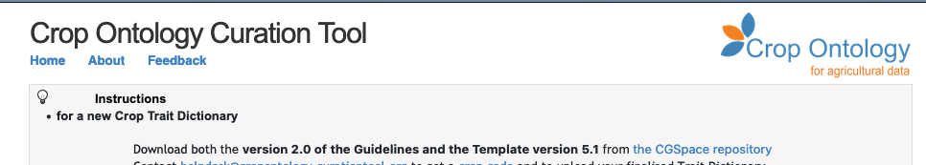



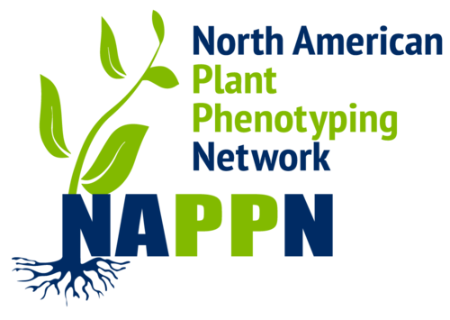

Crop ontology
Phenotype and Environment Traits description

Slide 2
Semantic in a nutshell

Slide 3
Semantic
Define concepts: plant, micro_plot, phenotype, experiment, event
Define Relations: micro_plot contains plant
Common Vocabularies and ontologies
Agrovoc, Plant Ontology, Crop Ontology, Environment Ontology, …
Study
Genotype
Observation Unit
Factor
hasGenotype
Treatment
Treatments
Plant
Measure
contains
is-applied
contains
Value
Time
micro_plot
plot
Ontology

Slide 4


Semantic Inference
Uncouple
Data capture
Data analysis
Data reuse
Inference allows to format the data for a target use
Plant
hasGenotype
Genotype
hasGenotype
contains
Micro-Plot
factors
treatment
is-applied
contains
is-applied
Plot

Slide 5
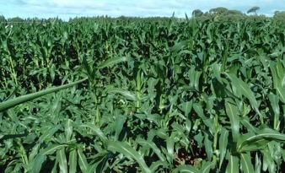
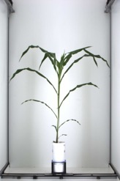

Annotation of events: plot and plant accidents
anno480
oa:hasTarget
Plot 97
Plot 98
plot97
dcterms:creator
dcterms:created
oa:bodyValue
"2017-06-29”
‘Plots lodged after the storm’
Romain
anno86
oa:hasTarget
plant795
dcterms:creator
dcterms:created
oa:bodyValue
"2017-05-15”
‘Fallen plant during imaging’
Llorenç
Events or follow the Web Annotation Data Model that allows assigning motivation and purpose attributes to annotations (e.g. oa:describing, oa:identifying, oa:linking, oa: replying, etc.). Dublin Core properties such as dcterms:created or dcterms:creator are also used.
L. Cabrera-Bosquet & P. Neveu

Slide 6
CROP ONTOLOGY and Planteome
www.cropontology.org
Elizabeth Arnaud, Marie Angélique Laporte et al.

Slide 7


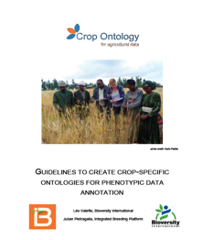
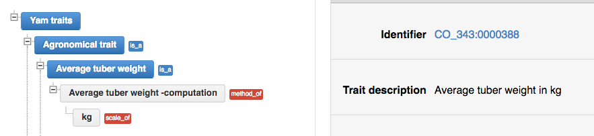
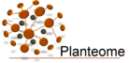
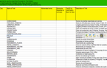

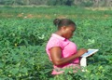
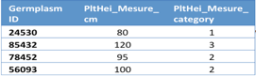
Crop Ontology for Trait Data
www.cropontology.org
27 Plants (latest Sugar Kelp - algae)
Good Practice for Trait Data Annotation
Submission of new traits & variables
Community selects traits and standard variables
Create Fieldbook with Ontology
Data collect
with standard variables
Formatted files in repositories or databases
Use of the formatted
data files

Slide 8



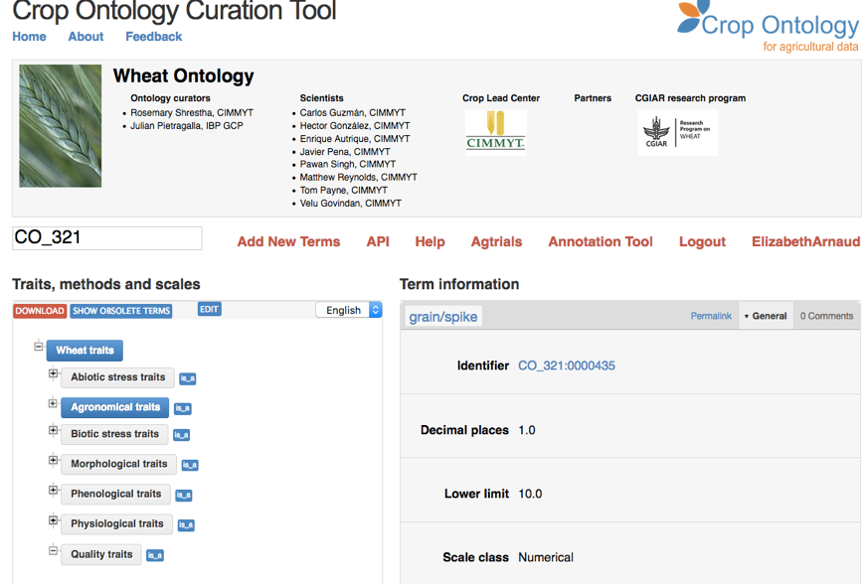
www.cropontology.org
Banana
Barley
Beet
Brachiaria
Brassica
Cassava
Castor bean
Chickpea
Common bean
Cowpea
Groundnut
Lentil
Maize
Mungbean
Oat (Global Triticeae)
Pearl millet
Pigeon Pea
Potato
Soybean (IITA & USDA)
Sweet Potato
Rice
Sorghum
Vitis (INRA)
Wheat (CIMMYT + INRAE)
Woody species
Yam

Slide 9









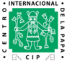










Where is Crop Ontology applied?
WheatIS Interoperability
Cookbook
CGIAR
repositories
Notes:
BMS: At the source! Edition of fieldbooks
Agtrials= env 30 000 CO annotated trials

Slide 10


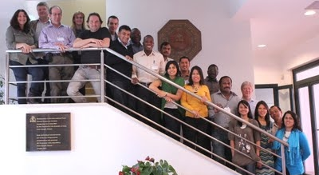
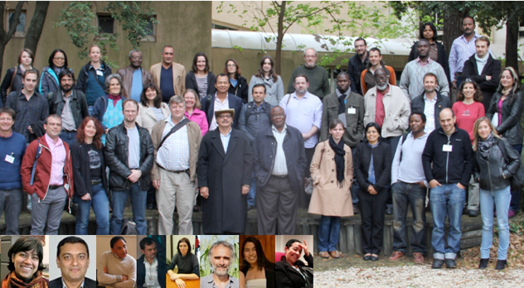
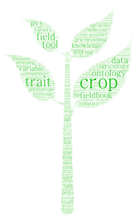
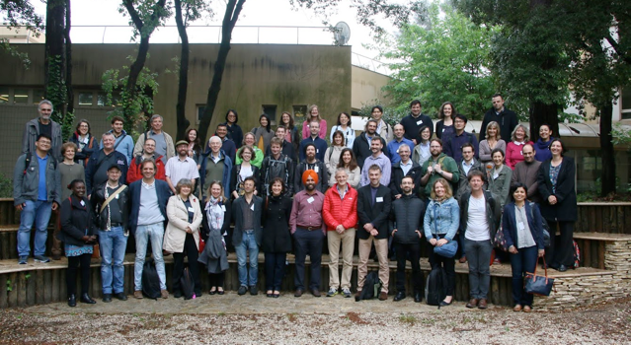
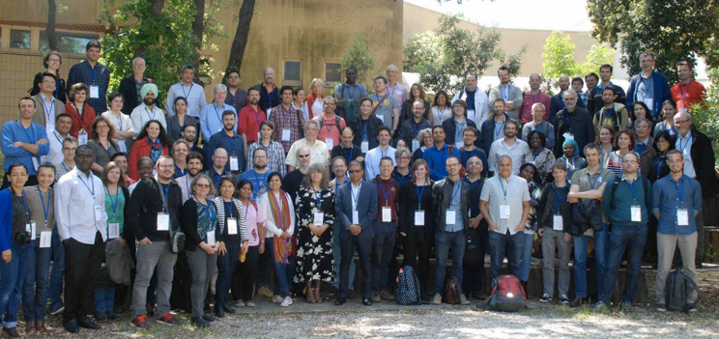
A Growing Community Of Practice
2012
2014
Upload your CoP Photo !
2016
2018

Slide 11

Reference Plant Ontologies
Mapping to species agnostic ontologies
to expand results of a crop trait search

Slide 12


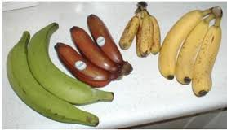
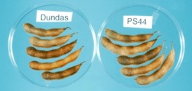
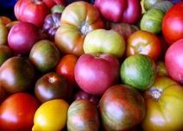
Common Reference Ontology
Finger color
Banana Traits
Fruit Color
Berry color
Pod color
Reference
Trait Ontology
Soybean Traits
Tomato Traits

Slide 13
CROP ONTOLOGY in miappe

Slide 14

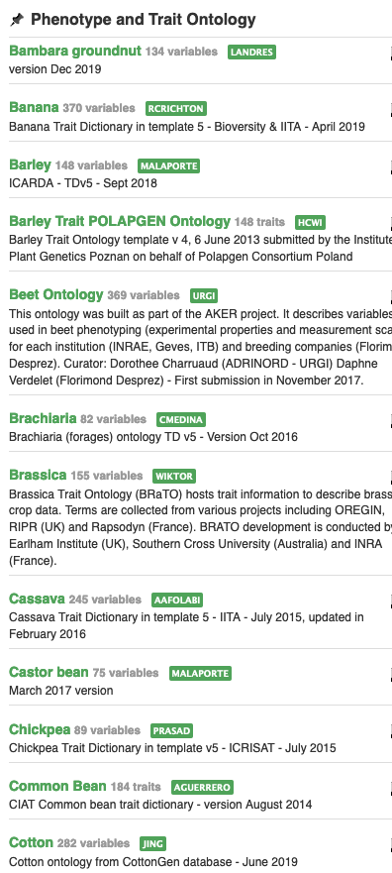
Context
Need
Importance of controlled vocabularies and ontologies for data annotation and FAIRness
Must respect crop specificities
Answer
Development of a standard to build ontologies to annotate phenotypes: “Crop Ontology”
Crop-specific vocabulary established by its community
31 ontologies crop-specific available (including woody plants): www.cropontology.org
Study | Genotype | CIR | HT | SUR
Domaine de Valcros | 6579 | 600 | 17 | 1
Domaine de Valcros | 6580 | 482 | 14 | 1
Study | Genotype | H | CIR
La Nerthe | 6579 | 23 | 650
La Nerthe | 6580 | 28 | 514

Slide 15
Standard model
Variable = trait + method + scale
The phenotypic observation
Trial | Genotype | CIR | HT | SUR
Domaine de Valcros | 6579 | 600 | 17 | 1
Domaine de Valcros | 6580 | 482 | 14 | 1
Variable | Variable ID
 | Variable name
 | Variable synonyms
 | Context of use
 | Growth stage
 | Variable status
 | Variable Xref
 | Institution
 | Scientist
 | Date
 | Language
 | Crop

Slide 16
Standard model
Variable = trait + method + scale
What is the studied character?
Trial | Genotype | CIR | HT | SUR
Domaine de Valcros | 6579 | 600 | 17 | 1
Domaine de Valcros | 6580 | 482 | 14 | 1
Trait | Trait ID
 | Trait
 | Trait class
 | Trait description
 | Trait synonyms
 | Main trait abbreviation
 | Alternative trait abbreviations
 | Entity
 | Attribute
 | Trait status
 | Trait Xref
Circumference of the tree
Total height of the tree
Survival state of the tree

Slide 17
Standard model
Variable = trait + method + scale
How is it observed?
Trial | Genotype | CIR | HT | SUR
Domaine de Valcros | 6579 | 600 | 17 | 1
Domaine de Valcros | 6580 | 482 | 14 | 1
Method | Method ID
 | Method
 | Method class
 | Method description
 | Formula
 | Method reference
Measured at breast height with a graduated ribbon
Measured from soil to crown with a pole or a clinometer
Visual assessment with a reference scoring scale

Slide 18
Standard model
Variable = trait + method + scale
How is it expressed (unit or scale)?
Trial | Genotype | CIR | HT | SUR
Domaine de Valcros | 6579 | 600 | 17 | 1
Domaine de Valcros | 6580 | 482 | 14 | 1
Scale | Scale ID
 | Scale name
 | Scale class
 | Decimal places
 | Lower limit
 | Upper limit
 | Scale Xref
 | Category 1
 | Category 2
 | …
 | Category n
cm
mm
0 = Alive
1 = Dead
2 = Doubtful

Slide 19
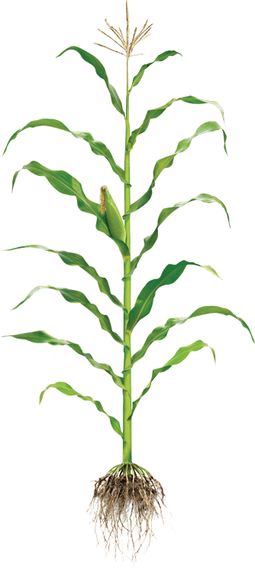
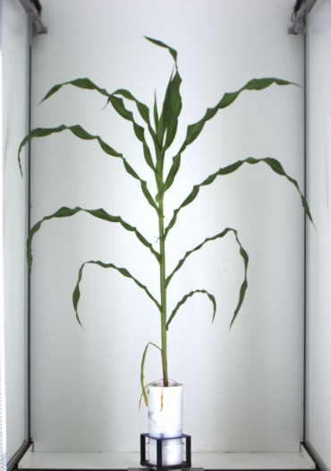

Controlled Vocabulary Challenge
Phenotyping/environment variable = Trait + Method + Unit/Scale
+
+
Trait
Method
Unit
M1: Total height
M2: First tassel branch
M3: Last expanded leaf
M4: Youngest growing leaf
U1: cm
U2: mm
We need Species specific CV/Ontologies
BUT
Near infinite number of combination
T1: Plant Height
M5: Highest pixel corresponding to plant
U3: pixel
L Cabrera

Slide 20
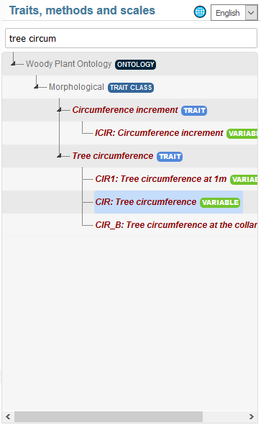
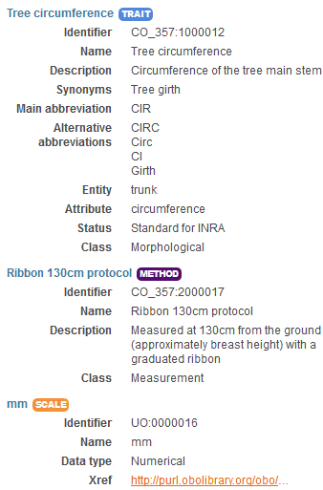
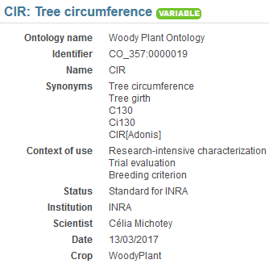
Tree Variable example1 https://urgi.versailles.inra.fr/ontologyportal#termIdentifier=CO_357:0000019
1 Trait
3 Variables
3 methods

Slide 21
BBCH scale, Woody Plant ontology example
Scale used to identify the phenological development stages of plants
Bud development
Leaf development
Stem development and elongation
Flowering
Fruit development
Senescence
Uses a decimal code system, which is divided into principal and secondary growth stages
Woody BBCH
Development of a BBCH scale for Forest Plants by the project TEMPO (French network of observatories dedicated to phenology for the entire living kingdom) => homogenize variables and facilitate data links
BBCH-scale available in the Woody Plant Ontology

Slide 22
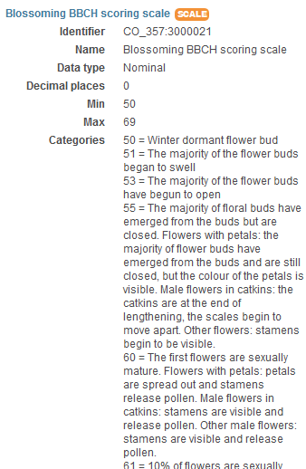
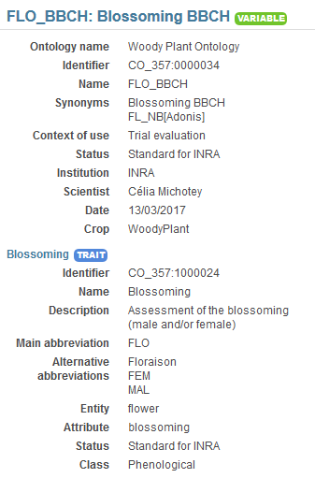
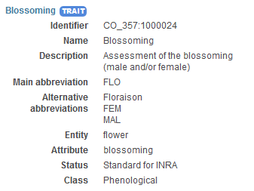
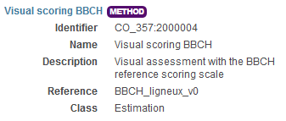
BBCH scale, Woody Plant ontology example

Slide 23
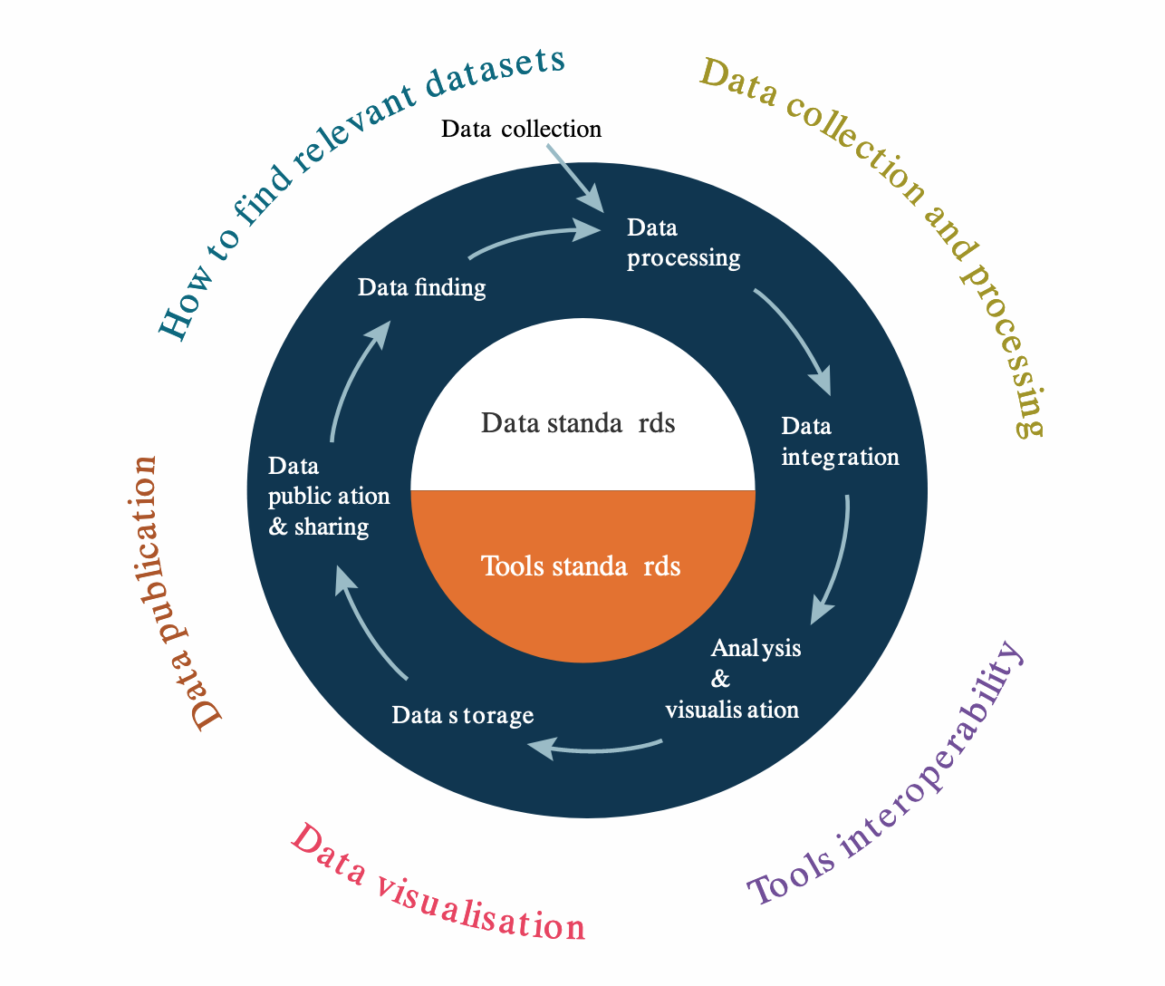
Take Home Message
Phenotyping Data relies on a complex lifecycle
Both:
Data acquisition
Deriving and reducing data
Linking different datasets
All steps must be defined → data management plan
Not all step of data must be shared
Raw data should be shared
Open science (policy): Publication and Findability are keys (Data tombs effect)
Minimal description:
Plant material
Studies/experiments
Variables
Provenance
=> Standardizing your data is good for you, good for others and getting easier!

Slide 24





















Acknowledgments
Elixir Plant community & platforms
Beier S., Gruden C., Pommier C., Coppens F, Scholz U., Lange M., Contreras B., Adam Blondon AF, Faria D, Chavez I, Miguel C, Droedsbek B, Finkers R, Papoutsoglou E, Olster R, Ramsak Z, …
H2020 AGENT
N. Stein (IPK, coord), P. Kersey (RBGK), M. Alaux (INRAE), S. Weise (IPK), C. Pommier (INRAE), M. Lange (IPK), R. Finkers (WUR), J. Destin (INRAE)
MIAPPE community
ELIXIR Plant Community,
Krajewsky P, Cwiek H, Tardieu F, Usadel B, Arend D, Arnaud E, Junker A, King G, Laporte MA, Poorter H, Reif J, Rocca-Serra P, Sansone SA, Kersey P,
And many more!
Crop Ontology
Arnaud E, Laporte MA, …
Breeding API
Selby P, Mueller L, Robbins K, Backlund JE, … ,
And many more!
Emphasis
Tardieu F, Usadel B, Arend D, Junker A, Poorter H, Neveu P, Pierushka R, Shur U…
And many more!

